Slide 1

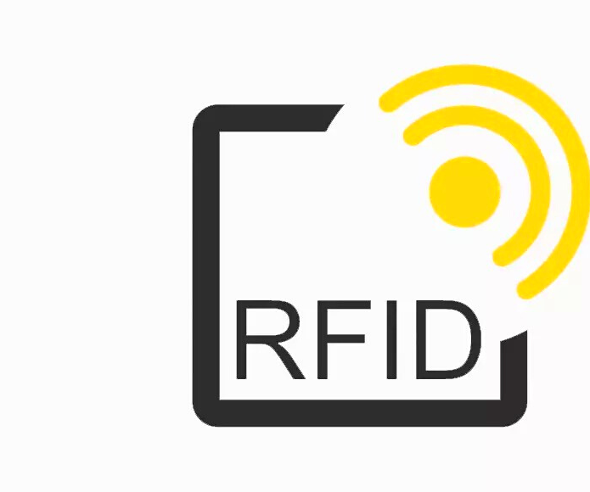
Car Parking System using RFID
EPICS PROJECT
PHASE 2 REVIEW 1
Guided by
Dr. Bhakti Parashar
(Assistant professor – VITBS)

Slide 2








Isha
19BCY10151
Oishik
19BCY10122
Himanshu
19BCY10138
Sakshi
19BEE10004
Aditi
19MIM10045
Rahul
19BCY10171
Somil
19BCE10278
Jayant
19BCY10106

Slide 3
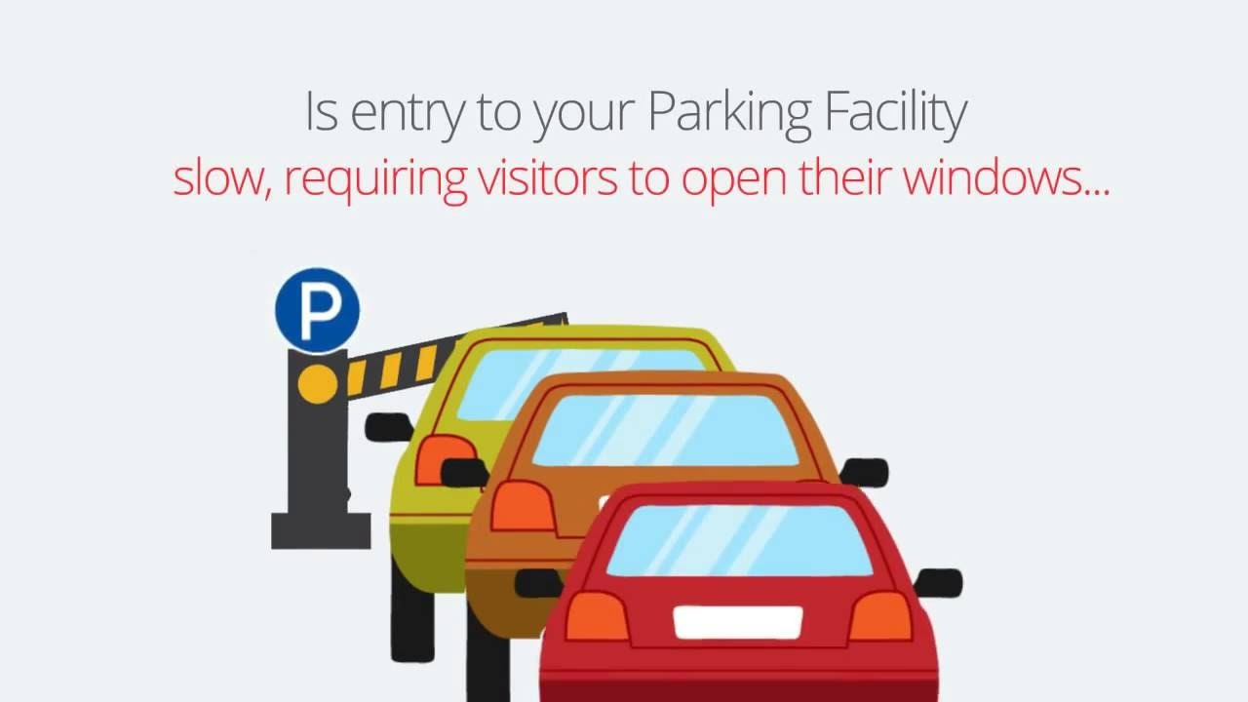

Slide 4

Literature Review

Slide 5
Paper 1
Smart Car Parking System Solution for the Internet of Things in Smart Cities . Wael Alsafery Department of Informatics University of Leicester, Leicester ,United Kingdom. Badraddin Alturki Department of Informatics University of Leicester, Leicester ,United Kingdom. Kamal Jambi Computer Science Department King Abdulaziz University ,Jeddah, Saudi Arabia.
The paper proposes a smart car parking system that will assist users to solve the issue of finding a parking space and to minimise the time spent in searching for the nearest available car park.
It provides users with roads traffic congestion status. Moreover, the proposed system collects the raw data locally and extracts features by applying data filtering and fusion techniques to reduce the transmitted data over the network
•For website
https://www.researchgate.net/publication/326997495_Smart_Car_Parking_System_Solution_for_the_Internet_of_Things_in_Smart_Cities
•Book
M. Suresh, P. S. Kumar, and T. Sundararajan, “Iot based airport parkingsystem,” in Innovations in Information, Embedded and CommunicationSystems (ICIIECS), 2015 International Conference on. IEEE, 2015,pp. 1–5.

Slide 6
Paper 2
The RFID technology and its Applications: A review 1Davindra Parkash, 2Twinkle Kundu & 3Preet Kaur 1Haryana College of Technology & Management, Ambala Road, Kaithal 136027, India 2Haryana College of Technology & Management, Ambala Road, Kaithal 136027, India 3YMCA University of Science And Technology, Sector-6,Faridabad, India
This paper givesa brief introduction to principles of RFID, classification of RFID tags and reader, frequencies used, current application, as well as advantages andlimitations.
Radio Frequency Identification (RFID) is one of most exciting technologies. The purpose of this paper is to review the RFID technology and its applications. This paper aims to review current development and future scope of this technology.
For website
https://www.researchgate.net/publication/232575248_THE_RFID_TECHNOLOGY_AND_ITS_APPLICATIONS_A_REVIEW
Book
B. H. Jeong, C. Y. Cheng, V. Prabhu, and B. J. Yu, “An RFID application model for surgery patient identification,”IEEE Symposiumon Advanced Managementof Information for Globalized Enterprises,AMIGE 2008, September 28 - September 29,pages 304–306, 2008.

Slide 7
Paper 3
Radio frequency identification (RFID) Based Car Parking System. Muhammad Syamil Mazlan, Isredza Rahi A Hamid, Hazalila Kamaludin .Faculty Science Computer and Information Technology, University Tum Hussein Onn, Malaysia
This paper brief reviews a parking system using RFID technology that can monitor vehicle's movement that enter or leave the specific area or place by scanning the RFID tag.
This parking system can facilitate access control for users and improve traffic flow during peaks period.
For website
https://www.researchgate.net/publication/327575252_Radio_Frequency_Identification_RFID_Based_Car_Parking_System
Book
A. H.Isredza Rahmi, Comparative study onRFID, hotspot and car plate scanning method : for intelligent parking management system. Masters thesis, Universiti Teknologi MARA. 2005

Slide 8


Problem Identification
Project Modules
1.RFID Module
2.Vehicle Parking
Management System
Conclusion
References
Contents

Slide 9
RFID based Car Parking System is a simple project that offers an efficient car parking management system with the help of RFID Technology.Car parking management in organisations and malls often consists of many tasks like issuing tokens, noting the check-in and check-out time, calculating fare and finally collecting the amount.
As the number of vehicles are increasing, the problems faced by manual parking management system are also increasing. Such problems can be eliminated to some extent by implementing an intelligent parking system where the entry and exit of cars is monitored with RFID technology.
This project deals with an interesting manner of security access based car parking system using arduino and RFID Technology.
Problem Identification

Slide 10
Project modules
RFID Module
Car Parking Management System
Smart Car Parking Systems

Slide 11
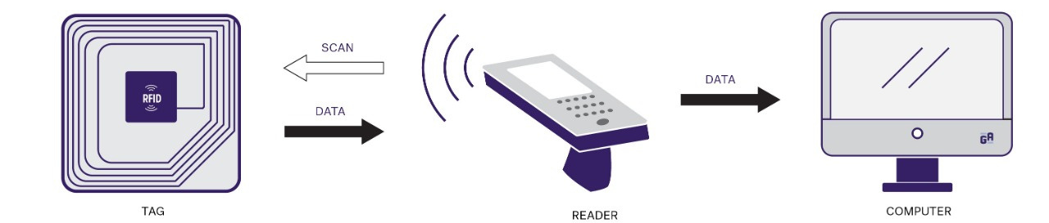
The RFID Module

Slide 12
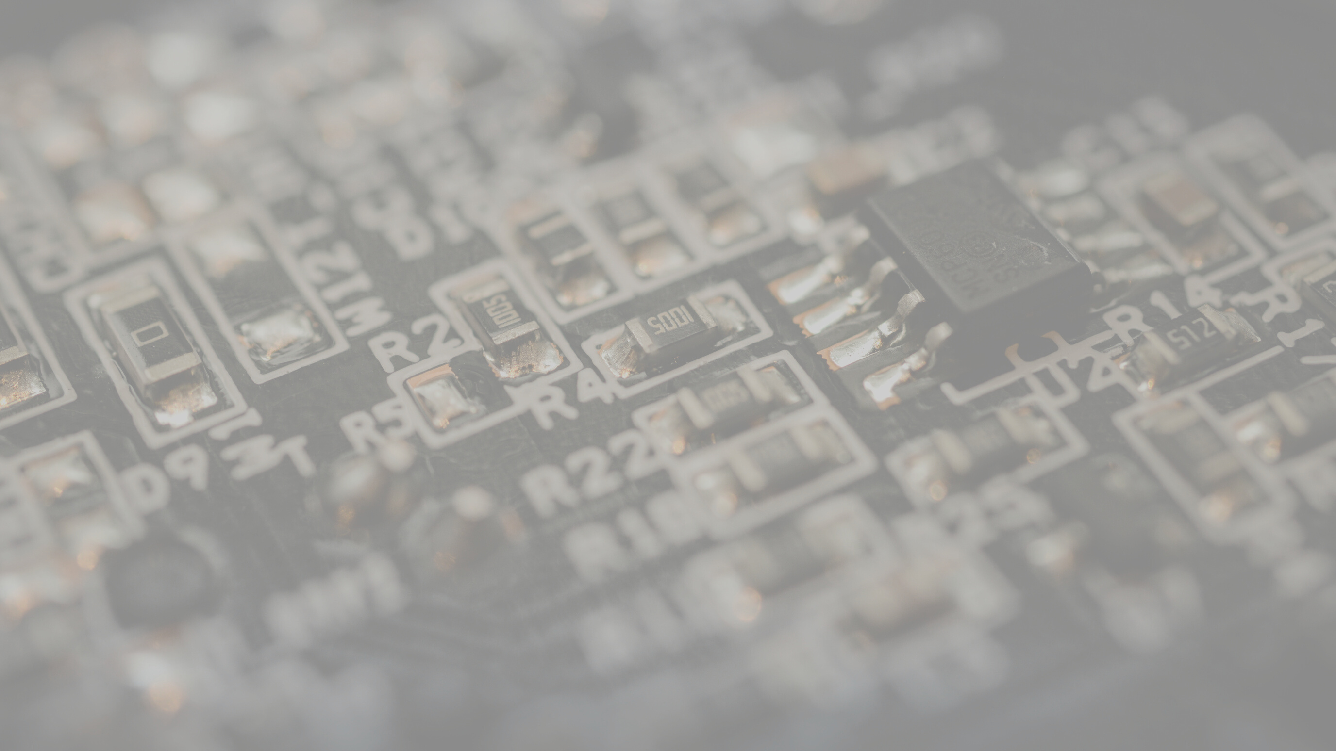
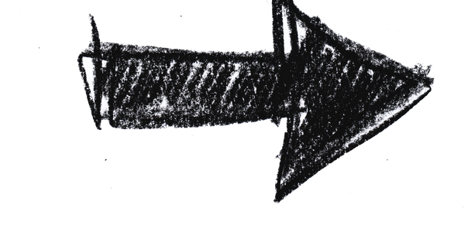
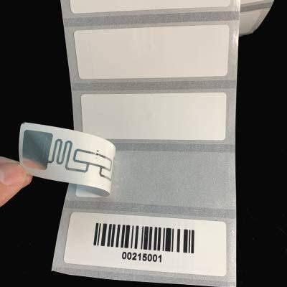
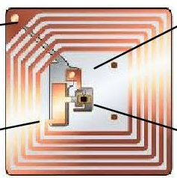
What is RFID Technology?
Radio Frequency Identification(RFID) refers to a wireless system comprised of two components: tags and readers.
A micro chip in a label used to transmit data when the label is exposed to radio waves

Slide 13
How does RFID work?
Tagging items with RFID tags allows users to automatically and uniquely identify and track inventory and assets. RFID takes auto-ID technology to the next level by allowing tags to be read without line of sight and, depending on the type of RFID, having a read range between a few centimeters to over 20+ meters.

Slide 14
RFID has come a long way from its first application of identifying airplanes as friend or foe in World War II. Not only does the technology continue to improve year over year, but the cost of implementing and using an RFID system continues to decrease, making RFID more cost-effective and efficient.

Slide 15
APPLICATIONS OF RFID
PEOPLE TRACKING
DOCUMENT TRACKING
GOVERNMENT LIBRARY
-

Slide 16
RFID applications in India
Departement of Road transport and Highways
Centre for Railway Information Systems(CRIS)
Apparrel Tracking using RFID
Used in Movie Theatres, Malls, Hospitals, Hotels, Market Places, etc.

Slide 17
ADVANTAGES
DISADVANTAGES
RFID are very simple to instal/inject inside the body of animals,thus helping to keep a track on them
It is difficult for an RFID reader to read the information in case of RFID tags installed in liquids and metal products
RFID technology has been referred to as invasive technology
The RFID tags can store data upto 20 MB.
RFID Technology cannot be easily replicated and therefor,it increases the security of the product.
Many countries have different range of frequencies that allows RFID tags to function.

Slide 18
Working
The project shows the design of an RFID based car parking system using arduino uno, in which only authorised personnel with valid RFID card are allowed access to park.
When the circuit is switched ON,the authorized person with RFID tag can enter.
When the ID card is detected by the reader, a unique card number is sent to the microcontroller.
If the card number is matched with saved number in microcontroller or database, the microcontroller will allow the car in order to park in the secured area , if not matched gate will not open for car to park

Slide 19
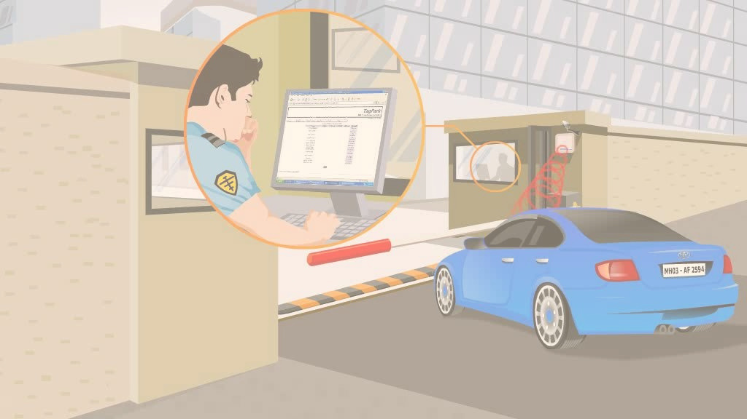
Vehicle Parking Management System using PHP and MySQL

Slide 20
In VPMS we use PHP and MySQL database. This is the project which keeps records of the vehicle which is going to park in the parking area. VPMS has one module i.e. admin.
Dashboard: In this sections, admin can briefly view the number of vehicle entries in a particular period.
Category: In this section, admin can manage category (add/update).
Add Vehicle: In this section, admin add vehicle which is going to park.
Manage Vehicle: In this section, admin can manage incoming and outgoing vehicle and admin can also add parking charges and his/her remarks.
Reports: In this section admin can generate vehicle entries reports between two dates.
Search: In this section,Admin can search a particular vehicle by parking number.
Admin can also update his profile, change the password and recover the password.

Slide 21
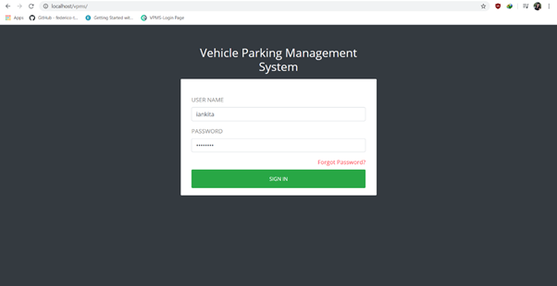
Fig.1 Start Page

Slide 22
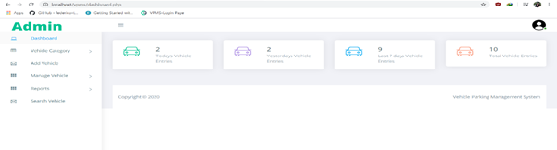
Fig.2 Dashboard

Slide 23
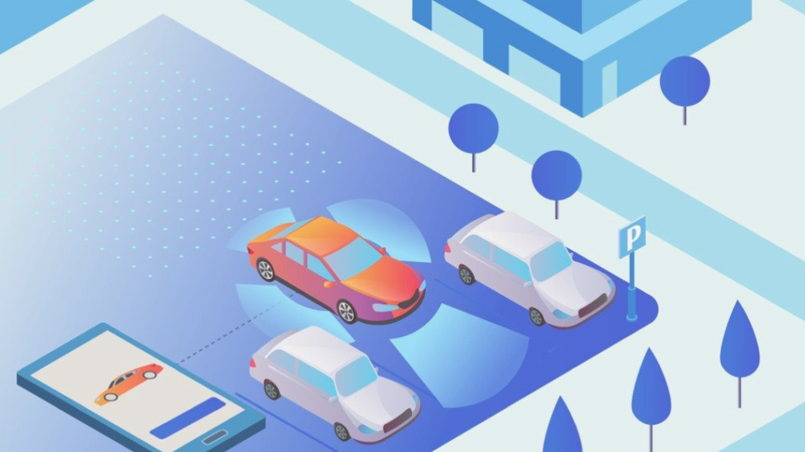
Smart Car Parking App

Slide 24
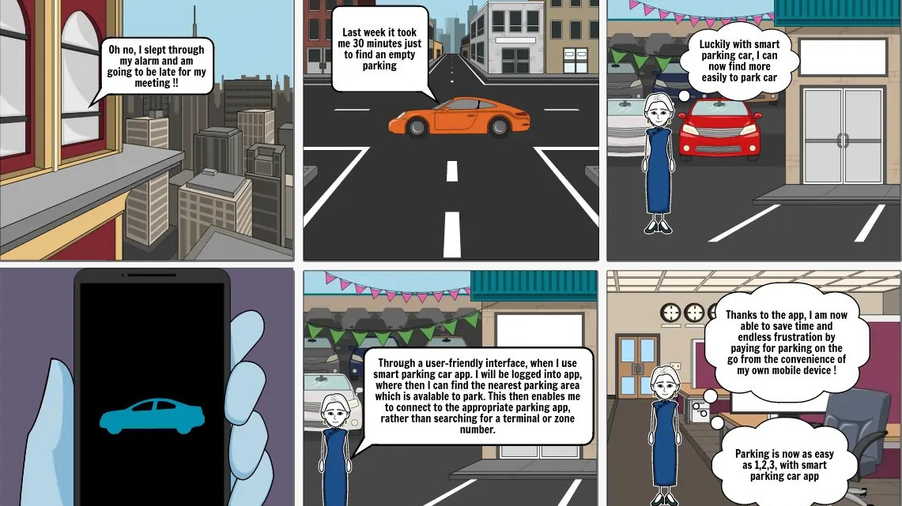

Slide 25
In car parking app, we use Javascript and Google Firebase. This app is for the users, in which they can check:
Available parking slots: Users can check the nearest available parking slots in the parking area.
Current Location Tracking: Users can track their vehicle's location, at any given time.
Entry & Exit time: Users can check their entry and exit timings.
Payment options: Users can choose from various payment options, like - Cash, UPI, Net-banking, etc.
Payment tariff: Here, users can view the payment rates.
Payment history: Users can check their past payment activities.
Account details: Users can view the account, they have created on this app.

Slide 26
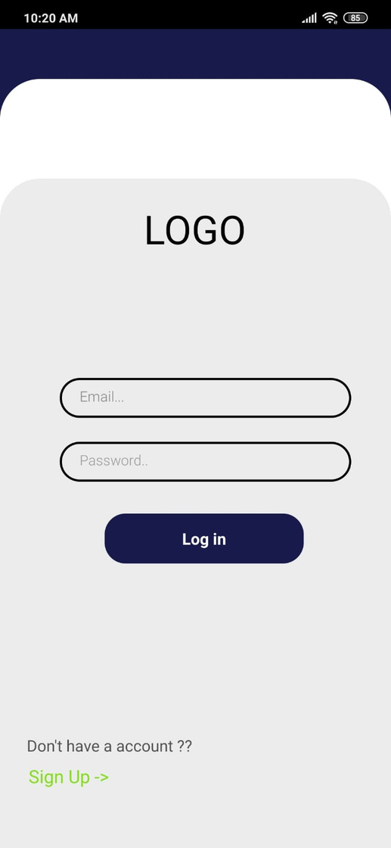
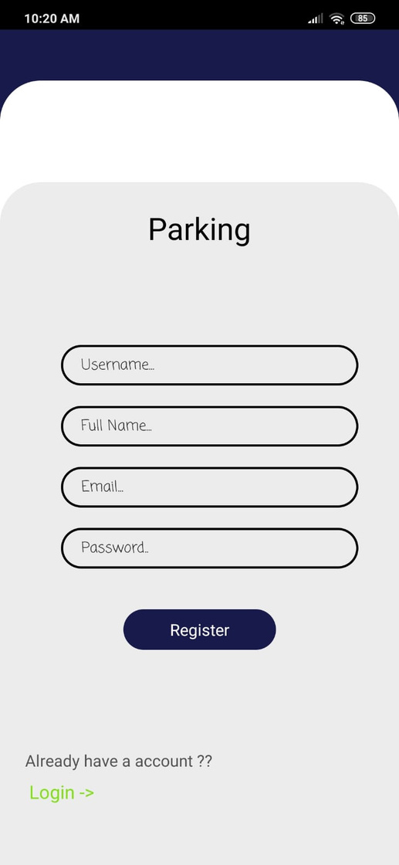

Fig. 1, Sign-in window
Fig.2, Sign-up window
Fig.3, Home Page

Slide 27
Conclusion
RFID technology is taking off in many places like in malls, libraries,etc at increasingly rapid pace. Though there are many firms employing this technology today, but due to its customizable feature and continuing improvement the communities are beginning to get involved in its development. It is easy to envision that, the RFID tags contents will increase in power , prices are expected to decline and tag will dramatically improve its efficiency,security and accuracy.

Slide 28

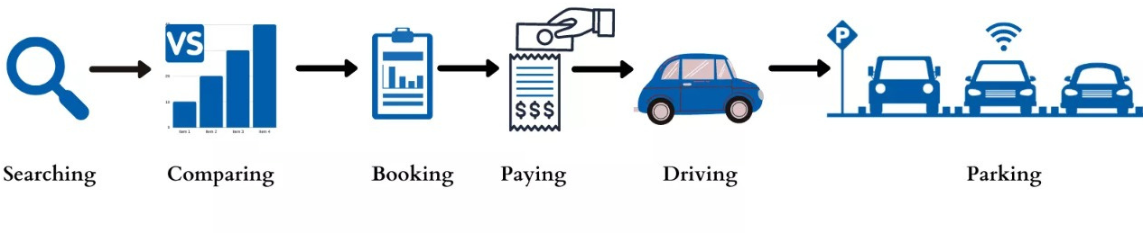

Slide 29

Disadvantages of RFID
Cost
Collision
Failure

Slide 30
Collision
Signals can collide when multiple singles are read at once.
Those signals are either lost or are read with errors.
At times the collision goes undetected for long periods of time .

Slide 31
People tracking system are used just as asset tracking system. Hospitals and jails are most general tracking required places.
Hospital uses RFID tags for tracking their special patients. In emergency patient and other essential equipment can easily track. It will be mainly very useful in mental care hospitals where doctors can track each and every activity of the patient. Hospitals also use these RFID tags for locating and tracking all the activities of the newly born babies.
The best use of the people tracking system will be in jails. It becomes an easy tracking system to track their inmates. Many jails of different US states like Michigan, California, and Arizona are already using RFID-tracking systems to keep a close eye on jail inmates.
Document Tracking:This is most common problem. Availability of large amount of data and documents brings lots of problem in document management system. An RFID document-tracking system saves time and money by substantially reducing:
Time spent searching for lost document
The financial and legal impact associated with losing documents.
GoMany government libraries use barcode and electromagnetic strips to track various assets. RFID technology uses for reading these barcodes unlike the self-barcode reader RFID powered barcode reader can read multiple items simultaneously. This reduces queues and increases the number of customers using self-check, which in turn will reduce the staff necessary at the circulation desks.

Slide 32
ACTIVE TAGS
Active RFID systems use battery-powered RFID tags that continuously broadcast their own signal.
The internal battery enables them to have extremely long read ranges as well as large memory banks.

Slide 33
PASSIVE TAGS
Passive RFID systems use tags with no internal power source and instead are powered by the electromagnetic energy transmitted from an RFID reader.
Passive RFID tags are used for applications such as access control, file tracking, race timing, supply chain management, smart labels, and more.

